Slide 1


Project Proposal: Food Demand
By: Kshitij Desai
October 8, 2021

Slide 2

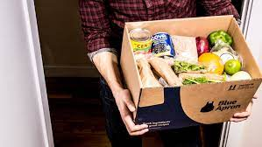
Problem Definition
I want to do an exploratory analysis and forecasting on demand for meal orders, so the company can better plan the stock of raw materials and staffing to reduce cost and increase their profits.

Slide 3
Project Description
Project Scope includes:
Analyze orders of different cuisine
Analyze orders in different centre types
Analyze orders of different categories
Analyze orders by different centres
Forecast the meal demand
I will not analyze the data before cleaning it
The data files I am planning to use are:
fulfilment_center_info.csv
meal_info.csv
train.csv
I have obtained these data files from Kaggle.com.
Exploratory Analysis will be used to model the data, and the insight from the research will be communicated. I will use forecasting to predict future meal demand.

Slide 4
Project Plan & Deliverables
PHASE EXPECTED COMPLETION TIME
Final Topic Selection October/12/2021
Data Collection and Prepping October/14/2021
Exploratory Analysis October/16/2021
Insights October/17/2021
Project uploaded in Canvas October/18/2021

